Slide 1

The Singapore Accord on the Standards of OHS Professionals
3 September 2017
Singapore
Notes:
Tell story of two advanced countries where a person attends two weeks of training to become “safety professionals”.
A high standard of safety professionalism will, undoubtedly, play a significant role in the prevention of accidents at work.
For those who are still trying to determine the standard a safety professional should meet, good news, there is now a standard that will be accepted by more than 12 safety professional and related organisations from 10 countries.

Slide 2
Agenda
What is the “Singapore Accord”
INSHPO Professional Framework
What the Singapore Accord means to your organization
The Singapore Accord

Slide 3

What is the “Singapore Accord”

Slide 4
Singapore Accord - What it is
Title: “Singapore Accord on the standards of OHS Professionals” (“Singapore Accord”)
An agreement by major OHS Practitioner Organisations and partners around the globe to aspire towards the standard of OHS Professional behaviour and practice;
Notes:
We believe that
Partnerships at various levels can bring greater success
In the prevention of accidents

Slide 5


Singapore Accord - What, When
Based on INSHPO’s OHS Professional Capability Framework - A Global Framework for Practice
Singapore Accord 3 September 2017 @

Slide 6
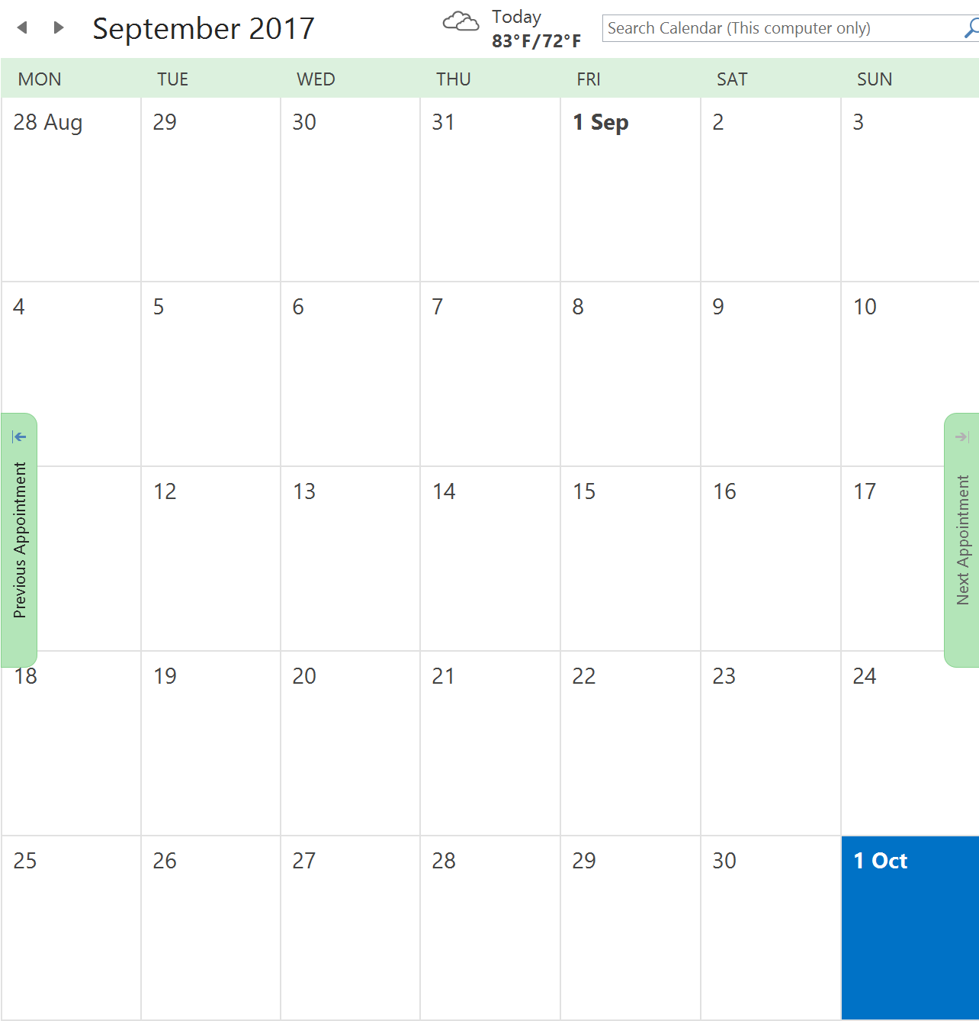
XXI World Congress on Safety and Health at Work 2017 Selected Events 2017
Singapore Accord Ceremony
3 Sep 2017 (Sun)
2:00pm [World Congress opens 5:00pm]
Singapore Accord Symposium@Congress
Symposium Topic: S29 - Workplace practices for a safe, healthy and productive work life
6 Sep 2017 (Wed) 9:00am to 11:00am
INSHPO
INSHPO
INSHPO
SISO A/P OHS Trainer’s Convention
Singapore Accord
XXI World Congress on
Safety and Health at Work 2017
APOSHO Committee Meetings
APOSHO Conference
APOSHO AGM

Slide 7









Singapore Accord - Initial Interest
At the INSHPO Annual Business Meeting in Vancouver on 17 Sep 2016, More than 12 safety professional and related organisations from 10 countries have indicated interest to sign the Singapore Accord.

Slide 8






















Singapore Accord - Initial Interest
At the APOSHO Interim Committee Meetings in Bangkok on 8 Dec 2016, 14 APOSHO members have indicated interest to sign the Singapore Accord.

Slide 9
Broad Timeline
Broad Timing | Activity
Ongoing | Invite formal Indicative Interest to be a signatory of or to support the Singapore Accord; Finalise text of the Singapore Accord. Administrative and physical co-ordination.
April 2017 | Communicate finalised Singapore Accord text to interested organisations.
April to June 2017 | Receive agreement, digital signatures and logo from signatory or supporting organisations. Extend formal invitation to attend the Singapore Accord Ceremony. (Note: Signatory or supporting organisations are to bear their own travel, accommodation and related costs. Organisers will bear the Singapore Accord event cost.)
July to mid-August 2017 | Finalise signed Singapore Accord for publication. Publish special Singapore Accord edition of the INSHPO’s OHS Professional Capability Framework - A Global Framework for Practice.
3 Sep 2017 | Singapore Accord Ceremony
6 Sep 2017 | Singapore Accord Symposium@Congress S29 - Workplace practices for a safe, healthy and productive work life

Slide 10
The INSHPO Professional Framework

Slide 11
Who is INSHPO
International Network of Safety & Health Practitioner Organisations
A Global Alliance dedicated to Advancing the Occupational Safety and Health Profession

Slide 12
INSHPO Member Organisations

Slide 13
INSHPO Professional Framework
An appreciation
Notes:
This set of pages will help participants know what the INSHPO Framework is.

Slide 14

Required of the OHS Professional
Activities
Knowledge
Skills

Slide 15
INSHPO Framework - Activities, knowledge and skills
Activities
Systems management
Organisational OHS culture
OHS risk management
Measurement and evaluation of OHS performance
Knowledge management
Communication, engagement and influence
Professional practice and ethics
Knowledge
1 Understanding
2 Routine application
3 Comprehensive application
4 Creative mastery
Hazards & risk
Hazards & risk controls
Safety & health management
Professional role
Underlying technical, human & social science
Underlying management science
Skills
1 Awareness
2 Routine application
3 Skilled application
4 Creative mastery
OHS Professional Technical Skills
Training
Surveying inspection & auditing
Measuring and monitoring
Professional Practice Skills
Evidenced-based practice
Empowerment
Leadership
Management
Professional practice
Knowledge management
Problem solving an critical thinking
Evidenced-based practice
Mentoring
Engagement
Teamwork
Negotiation & conflict management
Personal leadership
Project management & change management
Managing others
Professional practice
Ethical practice
Personal Skills
Verbal communication
Professional presentation skills
Notes:
The INSHPO Framework sets the standard expected of an OHS professional – in Activities that the professional should be able to do, in Knowledge, and in Skills .

Slide 16
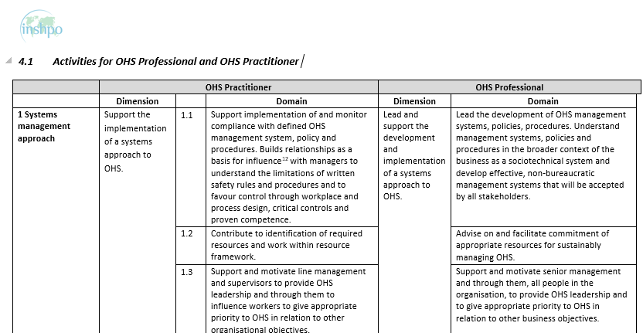
Activities
Notes:
An example of an activity that the OHS Professional should be able to perform. Read “Domain” for the actions that the OHS Professional should be able to do.

Slide 17
Knowledge
Topic areas
Hazards and risks
Hazard and risk controls
Safety and health management
Professional role and functioning
Underlying technical and social sciences
Underlying management science
Knowledge Level for each topic area:
Understanding
Routine application
Comprehensive application
Creative mastery
Notes:
An example of Topic Areas that the OHS Professional should know. Four levels of knowledge from just understanding to creative mastery.

Slide 18
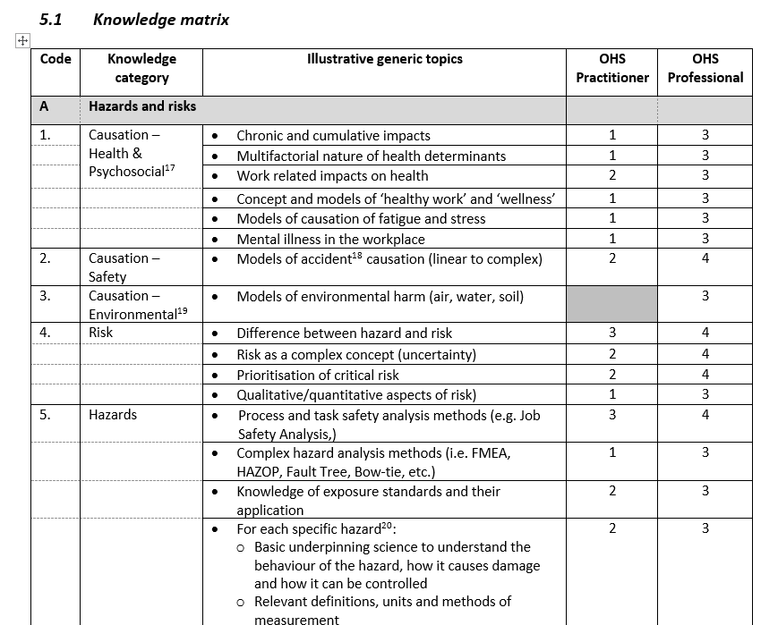
Knowledge Matrix
Notes:
An example of Topic Areas that the OHS Professional should know … more.

Slide 19
Skills
Skill Level
Awareness
Routine application
Skilled application
Creative mastery
Personal skills
Verbal communication
Professional presentation
Professional practice
Evidenced based practice
Influence
Leadership
Management
Professional & ethical practice
Professional technical skills
Training
Surveying, inspecting and auditing
Investigating
Measuring and monitoring
Notes:
An example of Skills that the OHS Professional should possess. Four levels of skills from just being aware to creative mastery.

Slide 20
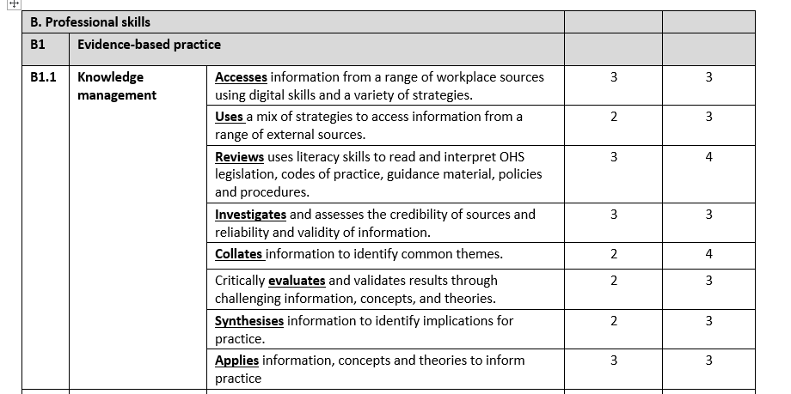
Example - Skills
Notes:
An example of Skills that the OHS Professional should possess. This is an example about Knowledge Management. Being able to Access, Use, Review, Investigate, Collate, Evaluate, Synthesise and Apply.

Slide 21
Better Capability
Activities
Knowledge
Skills
Notes:
The INSHPO Framework sets the standard expected of an OHS professional.

Slide 22
What the Singapore Accord means to your organisation

Slide 23
Singapore Accord - What does it mean to your organisation
Join other OHS organisation around the world to adopt a standard of OHS Professional behaviour and practice;
Use of INSHPO’s OHS Professional Capability Framework - A Global Framework for Practice
Gain recognition by being a signatory of the Singapore Accord

Slide 24
Singapore Accord
Come join OHS organisations from around the world to adopt a high standard of OHS Professional behaviour and practice!
Notes:
APOSHO individual organisation logo taken from APOSHO web. May not have all of them.

Slide 25
The Singapore Accord on the Standards of OHS Professionals

Slide 26
Singapore Accord on the Standards of OHS Professionals
Having met in Singapore on 3 September 2017, at the start of the XXI World Congress on Safety and Health at Work, representatives of business and workers, education institutions, policy-makers in governments and public authorities, OHS professional organisations, and experts in occupational health and safety (OHS) joined the International Network of Safety and Health Practitioner Organisations (INSHPO) and its members to sign the Singapore Accord, a commitment to improving OHS professional and practitioner capabilities so they may more effectively guide and lead the creation of healthier and safer workplaces.

Slide 27
Singapore Accord on the Standards of OHS Professionals
Acknowledgements
That according to the ILO, more than 2.3 million people die per year as a result of occupational accidents or work-related diseases. In addition, 317 million accidents occur on the job annually, resulting in significant human suffering and an economic burden estimated at 4% of the Gross Domestic Product.
That among the ILO goals is “to create worldwide awareness of the dimensions and consequences of work-related accidents, injuries and diseases and to place the health and safety of all workers on the international agenda and to stimulate practical action at all levels.”

Slide 28
Singapore Accord on the Standards of OHS Professionals
That a cornerstone to improving occupational health and safety performance and stimulating practical and effective preventative actions is a network of competent and capable professionals and practitioners.
That occupational health and safety professional and practitioner knowledge and skills must be evidence-informed and based on strong scientific and technical concepts.
That there is strong evidence from other professions that demonstrates the value of utilizing a common global framework for practice to establish defined and consistent standards or attributes required to undertake professional roles competently. For a common global framework for practice to be effective it must be well recognized and accepted by the profession, governments and business.

Slide 29
Singapore Accord on the Standards of OHS Professionals
That INSHPO has developed The Occupational Health and Safety (OHS) Professional Capability Framework - A Global Framework for Practice (Framework), a consensus-based tool developed to promote a high standard of capability for OHS professionals. The Framework defines the role, functions and competencies of OHS practitioners and professionals. It is based on an analysis of the practices of various professional associations, certification bodies and credentialing organisations and was subject to critical review, both through INSHPO’s own channels and at international conferences and presentations. The Framework provides generic guidance which may need to be adapted and developed in more detail by each organization to account for variations in regulations, histories and cultures as they pertain to OHS practice.

Slide 30
Singapore Accord on the Standards of OHS Professionals
Signatories to this agreement are in accord that:
We are committed to improving OHS professional and practitioner capabilities so they may more effectively guide and lead the creation of healthier and safer workplaces.
We are committed to promoting the use and acceptance of the Framework as a common platform to develop capable, knowledgeable, and skilled OHS professionals and practitioners across industry sectors and geographic borders.

Slide 31
Singapore Accord on the Standards of OHS Professionals
We are committed to striving to use the Framework to inform our work in relation to improving the competence and capability of the profession and thereby occupational health and safety standards across the world:
As OHS professionals and practitioners – as a reference and basis for gap analysis in relation to our professional practice and career development, to aid the development of continuing professional development plans to ensure that we are capable and competent;
As OHS member associations – in the development of professional educational programs and as a benchmark to ensure that our members possess relevant and up-to-date skills which allow them to undertake their role competently and effectively;

Slide 32
Singapore Accord on the Standards of OHS Professionals
As OHS certification bodies and credentialing organisations – as a resource in the development of our certification standards and designations, and other assessment processes;
As employers and human resource professionals – in developing position descriptions for OHS roles, in recruiting OHS personnel and in performance evaluation as a basis for professional development;
As OHS educators – in developing and reviewing OHS education programs;
As policy-makers in governments and public authorities – in the development of legislation or regulations that governs competent or reliable OHS advice or the role and development of OHS practitioners and professionals at workplaces.

Slide 33
Singapore Accord on the Standards of OHS Professionals
We are committed to continued cooperation and collaboration in developing global standards of practice for the purpose of improving the skills and capability of OHS professionals and practitioners and adapting the Framework to meet the needs of key stakeholders around the world.
---o0o---

Slide 34
The Singapore Accord on the Standards of OHS Professionals
Thank you.

